Slide 1


Data Analysis Of Google App’s Rating
Guide: Prof. N. G. Sharma
Team members:
Prathamesh Chaudhari(50)
Sanket Sutar(49)
Piyush Patil (51)
Rupesh Deshmukh (52)

Slide 2
Introduction
The Play Store apps data has enormous potential to drive app-making businesses to success. Actionable insights can be drawn for developers to work on and capture the Android market.
In this project we are going to analyze and predict google app rating with the help of machine learning algorithm.

Slide 3
Problem Statement
Predicting google app rating with the help of machine learning algorithms, so that we can derive business insights which will be useful for development of the application.
To solve this problem we can use data visualization tools and perform data analysis on given data, to get insights as fast as possible and without much manual work. It can give accurate insights.

Slide 4
Objectives
To do data pre-processing on google app’s dataset.
To do data analysis and visualization.
To predict google app rating with the help of KNN and Random Forrest.

Slide 5
Algorithms
K Nearest Neighbors
Random Forest Algorithm

Slide 6
K Nearest Neighbors
K-Nearest Neighbour is one of the simplest Machine Learning algorithms based on Supervised Learning technique.
K-NN algorithm can be used for Regression as well as for Classification but mostly it is used for the Classification problem.
K-NN is a non-parametric algorithm, which means it does not make any assumption on underlying data.
KNN algorithm at the training phase just stores the dataset and when it gets new data, then it classifies that data into a category that is much similar to the new data.

Slide 7
Random Forest Algorithm
Random Forest is a classifier that contains a number of decision trees on various subsets of the given dataset and takes the average to improve the predictive accuracy of that dataset.
Instead of relying on one decision tree, the random forest takes the prediction from each tree and based on the majority votes of predictions, and it predicts the final output.
Random decision forests correct for decision trees' habit of overfitting to their training set .
Random forests are frequently used as "blackbox" models in businesses, as they generate reasonable predictions across a wide range of data while requiring little configuration in packages such as scikit-learn.

Slide 8
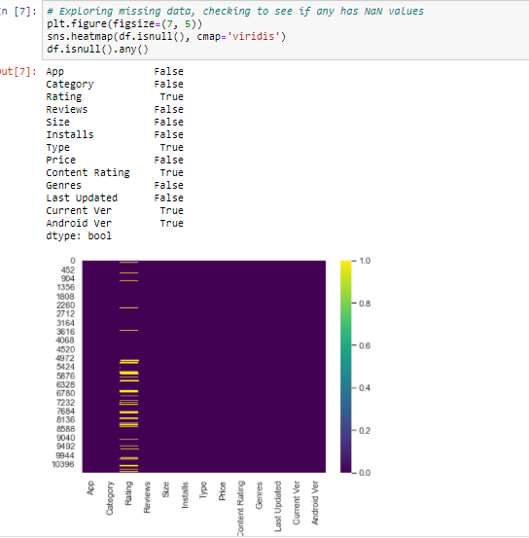
Screenshot

Slide 9
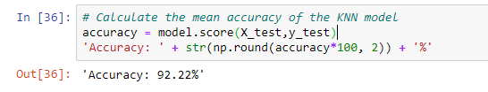
Screenshot of Outputs

Slide 10
Conclusion
After undergoing these algorithms and process, we concluded that our hypothesis is true. Meaning you can predict the app ratings, however significant preprocessing must be done before you start the classification and regression processes. This shows that given the Size, Type, Price, Content Rating, and Genre of an app, we can predict about 91% accuracy.

